Slide 1
Creating Apps with Open AI

Slide 2
Chatbot – PEXABot
Get workspace details for PEXA Exchange/Pexa Go
using signed contract (house address, buyer and seller details, etc) .

Slide 3
Demo Of PEXABot

Slide 4
Tech Stack
Python
Lang Chain
Vector Database(Facebook AI Similarity Search(FAISS))
LLM (Open AI)
Chainlit (UI)
Postgres

Slide 5
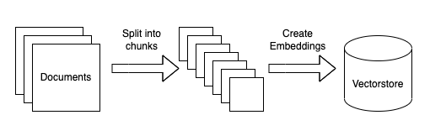
Ingestion

Slide 6
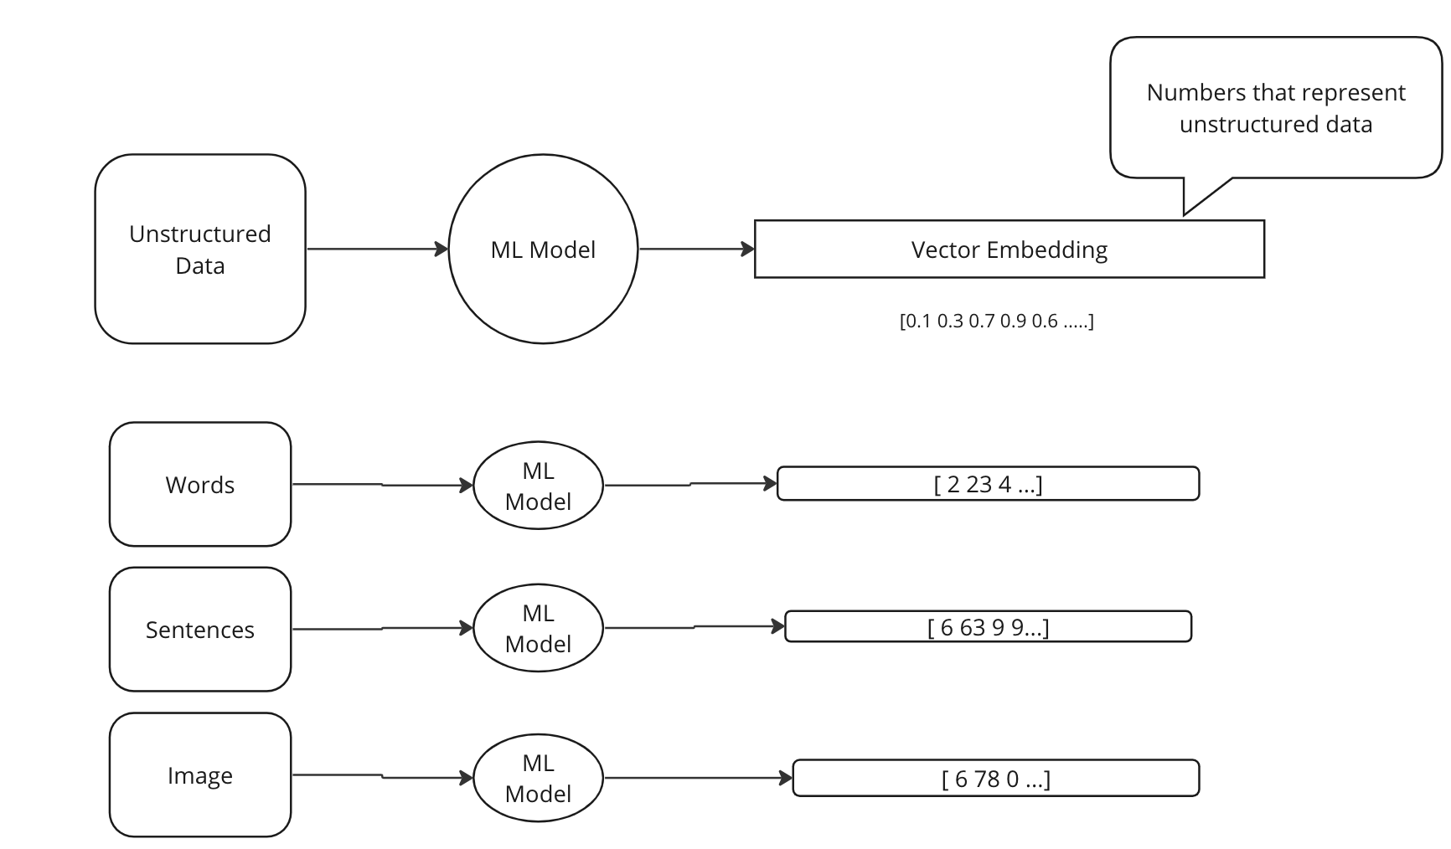
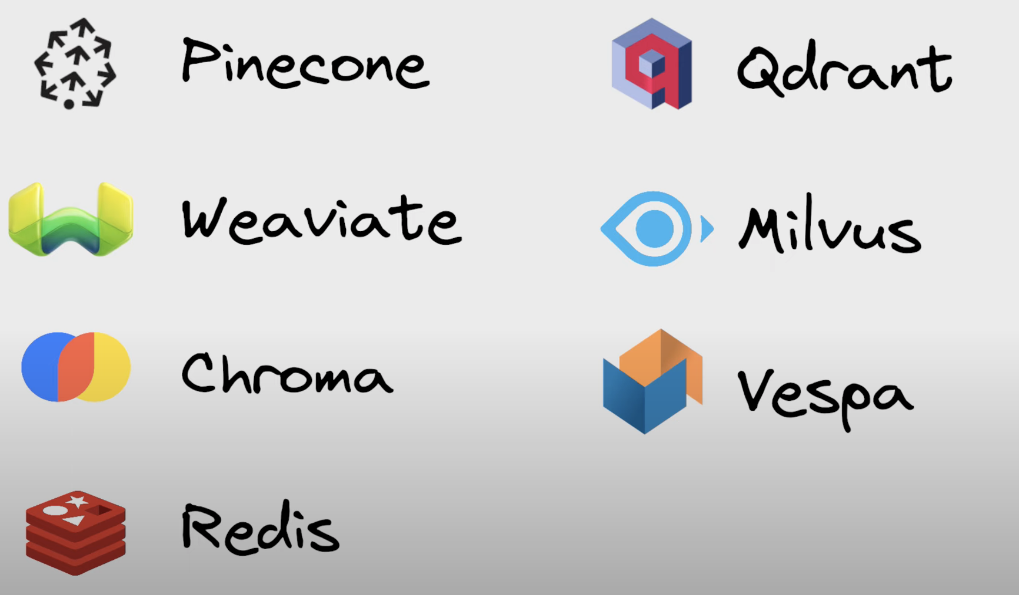
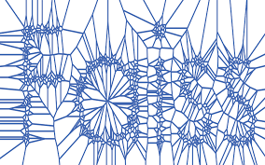
Vector Store
Store Unstructured Data as Vector Embedding
Semantic and Similarity search
Fast retrieval
FAISS

Slide 7
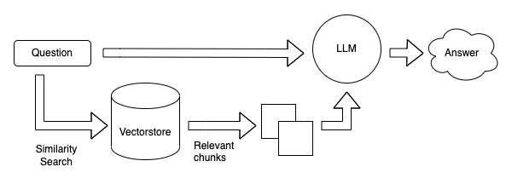
Query
Many LLM applications require user-specific data that is not part of the model's training set. The primary way of accomplishing this is through Retrieval Augmented Generation (RAG). In this process, external data is retrieved and then passed to the LLM when doing the query step.

Slide 8
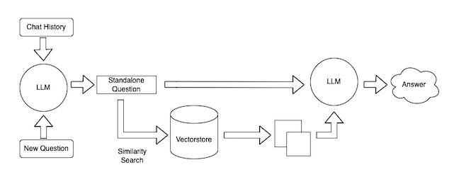
Query with memory

Slide 9
LangChain
LangChain gives you the building blocks to interface with any language model.
Document loaders https://python.langchain.com/docs/modules/data_connection/

Slide 10
OpenAI API
Prompt templates can be tested using OpenAI Playground

Slide 11
PEXABot Code Walkthrough

Slide 12
Any LLM’s to run on your Laptop?
GTP4All ( https://gpt4all.io/index.html)

Slide 13
Let’s transform PEXA into an AI first Company
Q & A

